Slide 1
Lecture 10 Pointers & Linked Lists
第10讲 指针和链表
华中科技大学计算机学院
李开
华中科技大学计算机学院

Slide 2
1 Introduction
Computational Thinking: We emphasize the importance of abstraction by producing a second implementation of the stacks and queues we introduced in the last lecture.
Algorithms and Data Structures: Linked lists are a fundamental data structure.
Programming: We will see structs and pointers, and the use of recursion in the definition of structs.
华中科技大学计算机学院

Slide 3
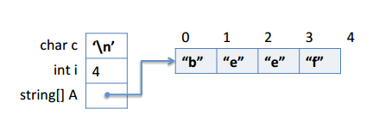
2 Structs and pointers
we’ve worked with five different C0 types – int, bool, char, string, and arrays t[].
The character, string, Boolean, and integer values that we manipulate, store locally, and pass to functions are just the values themselves; the picture we work with looks like this:
华中科技大学计算机学院

Slide 4
2 Structs and pointers (Cont.)
The next data structure we will consider is the struct.
A struct can be used to aggregate together different types of data, which helps us to create data structures.
In contrast, an array is an aggregate of elements of the same type.
华中科技大学计算机学院

Slide 5
2 Structs and pointers (Cont.)
Structs must be explicitly declared in order to define their “shape”.
For example:
typedef int pixel;
struct img_header {
pixel[ ] data;
int width;
int height;
};
华中科技大学计算机学院

Slide 6
2 结构体和指针（续）
Structs do not necessarily fit into a machine word because they can have arbitrarily many components, so they must be allocated on the heap (in memory, just like arrays).
This is true even if they happen to be small enough to fit into a word (in order to maintain a uniform and simple language implementation).
华中科技大学计算机学院

Slide 7
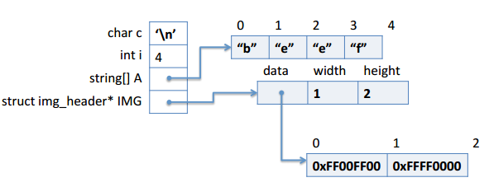
2 结构体和指针（续）
华中科技大学计算机学院

Slide 8
3 Pointers
As we have seen in the previous section, a pointer is needed to refer to a struct that has been allocated on the heap. In can also be used more generally to refer to an element of arbitrary type that has been allocated on the heap. For example:
--> int* ptr1 = alloc(int);
ptr1 is 0xFFAFC120 (int*)
--> *ptr1 = 16;
*(ptr1) is 16 (int)
--> *ptr1;
16 (int)
华中科技大学计算机学院

Slide 9
3 Pointers(Cont.)
So we would be tempted to say that a pointer value is simply an address. But this story, which was correct for arrays, is not quite correct for pointers. There is also a special value NULL. Its main feature is that NULL is not a valid address, so we cannot dereference it to obtain stored data. For example:
--> int* ptr2 = NULL;
ptr2 is NULL (int*)
--> *ptr2;
Error: null pointer was accessed
Last position: <stdio>:1.1-1.3
华中科技大学计算机学院

Slide 10
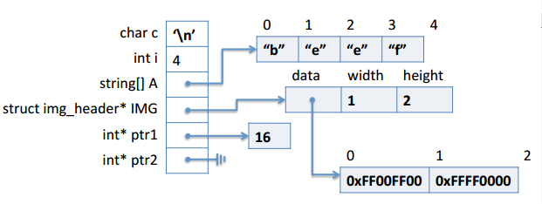
3 Pointers(Cont.)
华中科技大学计算机学院

Slide 11
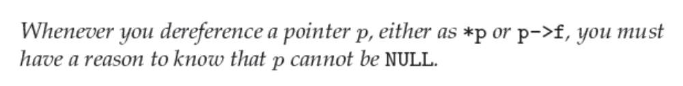
3 Pointers(Cont.)
Attempting to dereference the null pointer is a safety violation in the same class as trying to access an array with an out-of-bounds index. In C0, you will reliably get an error message, but in C the result is undefined and will not necessarily lead to an error. Therefore:
In many cases this may require function preconditions or loop invariants, just as for array accesses.
华中科技大学计算机学院

Slide 12
4 Linked Lists
Each item in a linked list contains a data element of some type and a pointer to the next item in the list.
It is easy to insert and delete elements in a linked list.
On the other hand access to an element in the middle of the list is usually O(n), where n is the length of the list.
华中科技大学计算机学院

Slide 13
4 Linked Lists(Cont.)
struct list_node {
elem data;
struct list_node* next;
};
typedef struct list_node list;
Keeping this in mind ensures that none of the code actually depends on what type is chosen.
This definition is an example of a recursive type.
The type definition is there to create the type name list, which stands for struct list_node, so that a pointer to a list node will be list*.
华中科技大学计算机学院

Slide 14
4 Linked Lists(Cont.)
There are some restriction on recursive types.
struct infinite {
int x;
struct infinite next;
};
would be rejected by the C0 compiler because it would require an infinite amount of space.
Linked lists are a concrete type which means we do not construct an interface and a layer of abstraction around them.
This is contrast to abstract types such as queues or stacks (see next lecture) whose implementation is hidden behind an interface, exporting only certain operations.
华中科技大学计算机学院

Slide 15
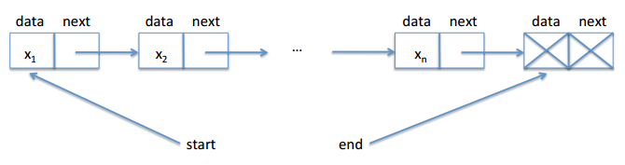
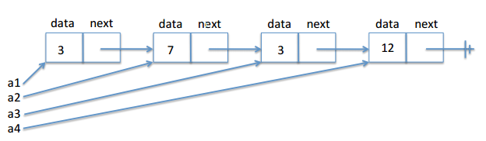
5 List segments
华中科技大学计算机学院

Slide 16
5 List segments(Cont.)
How can we check whether we have a segment from start to end?
Recursively ：
bool is_segment(list* start, list* end) {
if (start == NULL) return false;
if (start == end) return true;
return is_segment(start->next, end);
}
华中科技大学计算机学院

Slide 17
5 List segments(Cont.)
For loop ：
bool is_segment(list* start, list* end) {
for (list* p = start; p != NULL; p = p->next) {
if (p == end) return true;
}
return false;
}
华中科技大学计算机学院

Slide 18
5 List segments(Cont.)
While loop :
bool is_segment(list* start, list* end) {
list l = start;
while (l != NULL) {
if (l == end) return true;
l = l->next;
}
return false;
}
华中科技大学计算机学院

Slide 19
5 List segments(Cont.)
--> list* start = alloc(list);
--> start->data = 3;
--> start->next = alloc(list);
--> start->next->data = 7;
--> start->next->next = alloc(list);
--> start->next->next->data = 3;
--> start->next->next->next = alloc(list);
--> start->next->next->next->data = 12;
--> start->next->next->next->next = start->next;
--> list* end = alloc(list);
--> end->data = 18;
--> end->next = NULL;
--> is_segment(start, end);
华中科技大学计算机学院

Slide 20
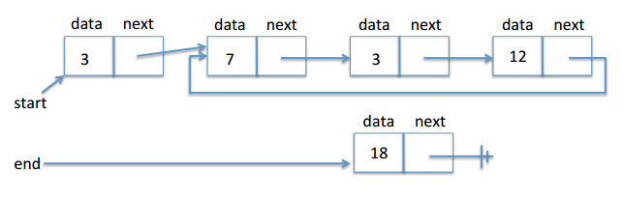
5 List segments(Cont.)
华中科技大学计算机学院

Slide 21
6 Checking for Circularity
In order to make sure the is_segment function correctly handles the case of cyclic loops, let’s write a function to detect whether a list segment is cyclic, so that is_segment can call it first.
bool is_segment(list* start, list* end) {
if (!is_acyclic(start, end)) return false; // start to end cyclic
// start to end is acyclic, check if it is a segment
....
}
华中科技大学计算机学院

Slide 22
6 Checking for Circularity(Cont.)
bool is_acyclic(list* start, list* end)
{
list* p = start;
while (p != end) {
if (p == NULL) return true;
for (list* q = start; q != p; q = q->next) {
if (q == p->next) return false; /* circular */
}
p = p->next;
}
return true;
}
华中科技大学计算机学院

Slide 23
6 Checking for Circularity(Cont.)
Create two pointers, a fast and a slow one. Let’s name them h for Achilles and t for tortoise.
The slow pointer t traverses the list in single steps. Fast h, on the other hand, skips two elements ahead for every step taken by t.
If the faster h starts out ahead of t and ever reaches the slow t, then it must have gone in a cycle.
华中科技大学计算机学院

Slide 24
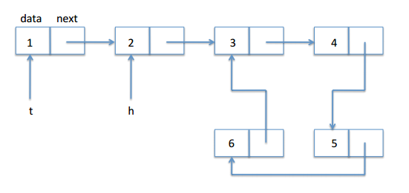
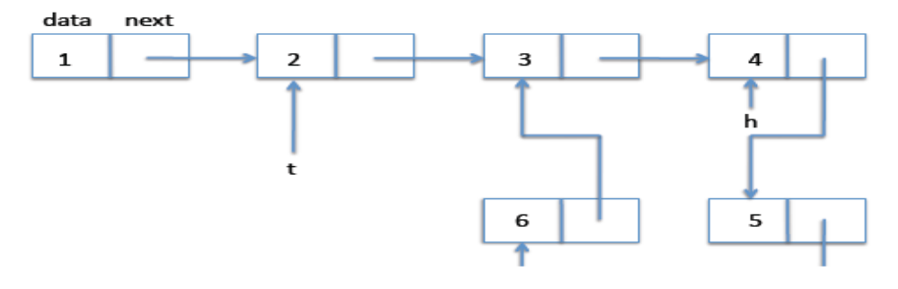
6 Checking for Circularity(Cont.)
华中科技大学计算机学院

Slide 25
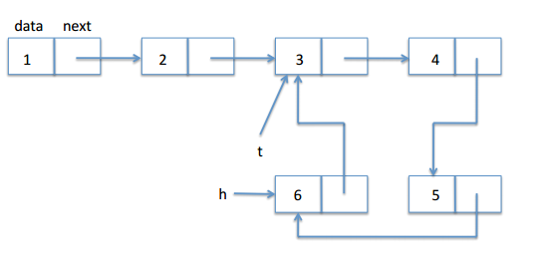
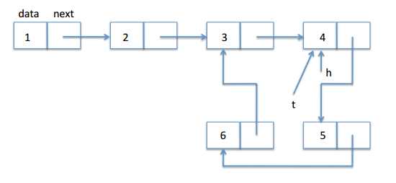
6 Checking for Circularity(Cont.)
华中科技大学计算机学院

Slide 26
6 Checking for Circularity(Cont.)
bool is_acyclic(list* start, list* end) {
if (start == NULL) return true;
list* h = start->next; // Achilles
list* t = start; // tortoise
while (h != t) {
if (h == NULL || h->next == NULL) return true;
h = h->next->next;
//@assert t != NULL; // Achilles is faster and hits NULL quicker
t = t->next;
}
//@assert h == t;
return false;
}
华中科技大学计算机学院

Slide 27
6 Checking for Circularity(Cont.)
bool is_acyclic(list* start, list* end) {
if (start == NULL) return true;
list* h = start->next; // Achilles
list* t = start; // tortoise
while (h != t) {
if (h == NULL || h->next == NULL) return true;
if (h == end || h->next == end) return true;
h = h->next->next;
//@assert t != NULL; // Achilles is faster and hits NULL quicker
t = t->next;
}
//@assert h == t;
return false;
}
华中科技大学计算机学院

Slide 28
7 Tortoise is Never NULL
bool is_acyclic(list* start, list* end) {
if (start == NULL) return true;
list* h = start->next; // Achilles
list* t = start; // tortoise
while (h != t)
//@loop_invariant is_segment(t, h);
{
if (h == NULL || h->next == NULL) return true;
if (h == end || h->next == end) return true;
h = h->next->next;
//@assert t != NULL;
t = t->next;
}
//@assert h == t;
return false;
}
华中科技大学计算机学院

